Slide 1
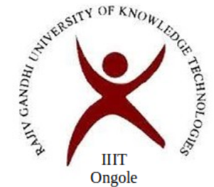
Arduino Fingerprint Security Lock
Submitted by:- Submitted to:- O161636-K.Kamal Hanesha V.Leeladhar O161817-K.Ganapathi Reddy O160793-G.Naveen O161881-M.Swetha O161724-V.Jenifer

Slide 2
Contents
Introduction
Components
Circuit diagram
Working
Advantages and Disadvantages
Applications and Conclusion

Slide 3
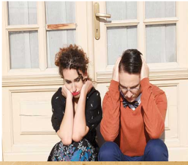
How often do you see someone forget or worst case scenario lose his keys,while everyone is waiting for him to unlock the door? Pretty terrifying right? So, Solution for this is....

Slide 4
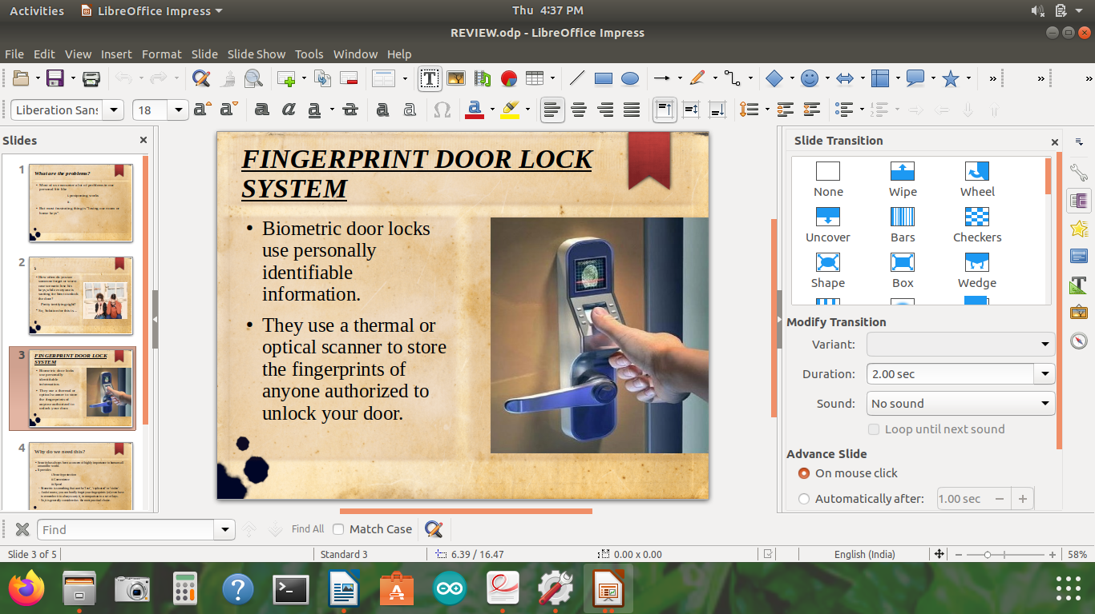
Biometric door locks use personally identifiable information.
They use a thermal or optical scanner to store the fingerprints of anyone authorized to unlock your door.

Slide 5
Why we need this?
Security has always been a concern of highly important to humans all around the world.
It provides i.Security protection ii.Convenience iii.Speed
Biometric is something that cant be ‘lost’, ‘replicated’ or ‘stolen’.
And ofcourse, you can hardly forget your fingerprints (or) even have to remember it to always carry it, in comparison to a set of keys.
So,it is generally considered as the most practical choice.

Slide 6

Why can’t these
Iris recognition : It’s installation cost is very high and scanning the human eye is a sensitive issue that many find alarming.
voice recognition:Though it is less expenisive,but often find hard when a person have illness like hoarseness or other throat problems.

Slide 7

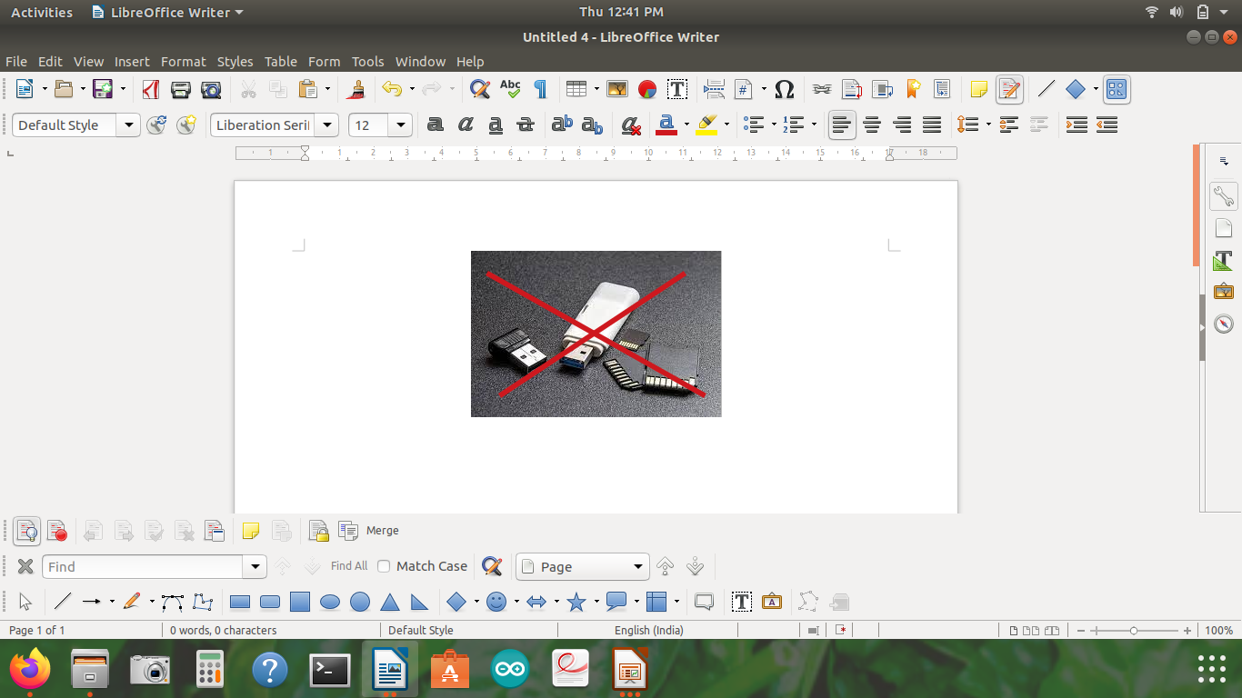
Introduction
Cost efficient
External memory is not required.
It is simple
It is a control access system
Security
Authentication

Slide 8


Introduction
Key locks are very less secure.
Crime rate is increasing day by day.
The algorithm used is “matching algorithm.

Slide 9
Components required
Name of the component | No.of pieces | Cost
Arduino uno r3 | 1 | 384Rs/-
Fingerprint scanner r307 | 1 | 795Rs/-
Linear solenoid | 1 | 315Rs/-
Single channel relay | 1 | 60Rs/-
Breadboards | 1 | 76Rs/-
Usb cable and other components | - | 355Rs/-
Total Cost | - | 1949Rs/-

Slide 10
Arduino Uno R3
The Arduino Uno(one) is a open source microcontroller board based on the Microchip (its a manufacturer company) ATmega328P( its a single chip microcontroller ) and developed by Arduiono.cc .
The board has 14 digital I/O pins (six capable of PWM output), 6 analog I/O pins, and is programmable with the Arduino IDE (Integrated Development Environment), via a type B USB cable.
It can be powered by the USB cable or by an external 9-volt battery,though it accepts voltages between 7 and 20 volts
It is inexpensive and compatible
Programming is simple

Slide 11
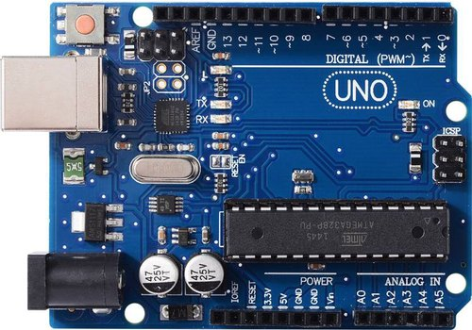
Arduino Uno R3 Specifications
1) It is an ATmega328P based Microcontroller.
2) The Operating Voltage of the Arduino is 5V.
3)The recommended input voltage ranges
from 7V to 12V.The i/p voltage (limit) is
6V to 20V.
4) DC Current for each I/O Pin is 20mA.
5) DC Current used for 3.3V Pin is 50mA.
6) In Built LED and speed of the CLK is 16MHZ.
7) The weight of the Arduino board is 25g.

Slide 12
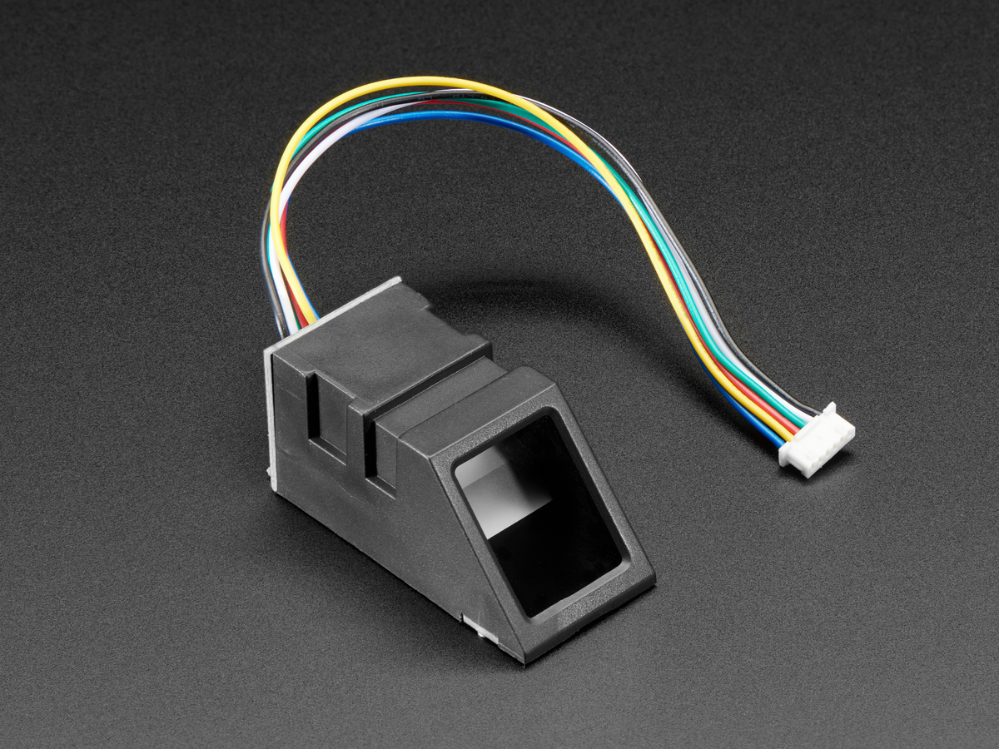
Fingerprint Scanner R307
➔ There are two types of fingerprint sensors
1) Optical 2)Capacitive
➔ Mostly we use optical fingerprint scanners
because they are less accessible to
discharge.
➔Here It can store 137 fingerprints
so no need external memory.
➔Fingerprint sensor capture the image of the fingerprint and make the pattern inside the memory of the fingerprint. the shape of the pattern will break into the binary code and then save into the memory of the fingerprint.

Slide 13
Fingerprint Scanner R307 Specifications
Interface:TTL serial
Baudrate:9600,19200,28800,38400,57600(default is 57600)
working temperature rating:-20c to +50c
working humidity:40%-85%RH
Full dimensions:56x20x21.5mm
weight:20 grams
Supply voltage:3.6-6.0vdc
Operating current:120m
Fingerprint imaging time:<1.0seconds
Window area:14mm x 18mm
storage capacity:162 templates
false reject rate:<1.0%

Slide 14
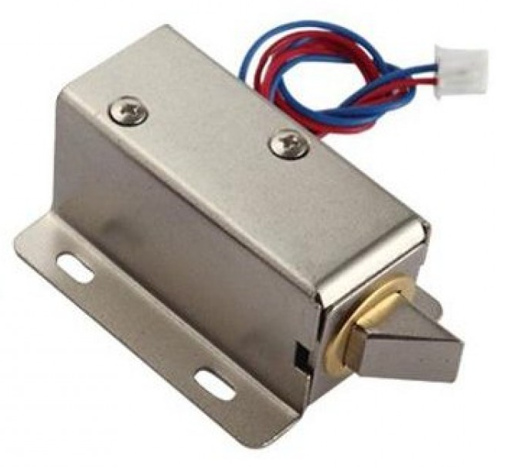
Linear Solenoid 12V DC
It converts electrical energy into mechanical work.
It is a electrical locking and unlocking lock in the power on mode.
It requires more current to convert electrical energy into mechanical work.

Slide 15
Linear Solenoid 12V DC Specifications
Stroke up to 30mm(depending on type).
Holding force up to 2,000N(in end position,energized).
High lifetime:up to 50 million cycles and more.
Fast response time:switching time<5ms possible(depending on size).
Standarad sizes from 11mm to 874mm diameter

Slide 16
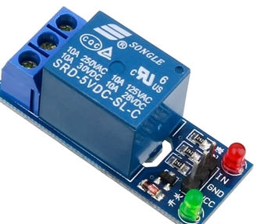
Single Channel Relay
It is a electromechanical device
It acts as indicators sometimes
It is used to control high
voltage,high current load such as
motor,solenoid..etc
Single channel relay module is used to control
high voltage,high current load such as motor,solenoid values,lamps and AC loads.

Slide 17
Single Channel Relay Specifications
Supply voltage-3.75v to 6v
Quiescent current:2mA
Current when the relay is active:70mA
Relay maximum contact voltage-250VAC or 30VDC
Relay maximum current-10A

Slide 18
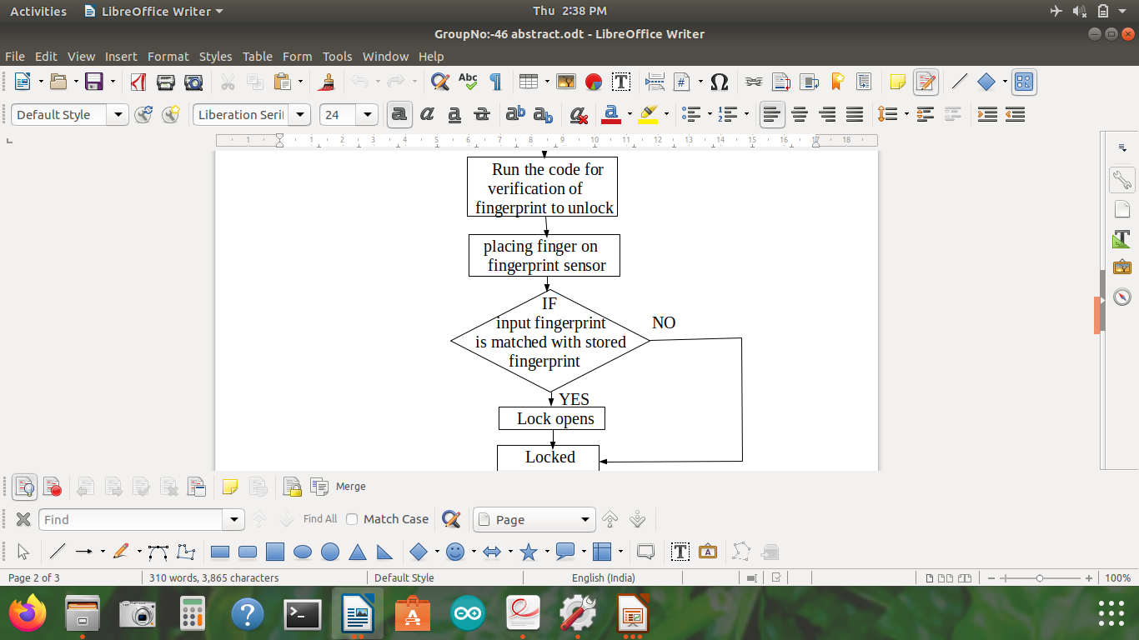
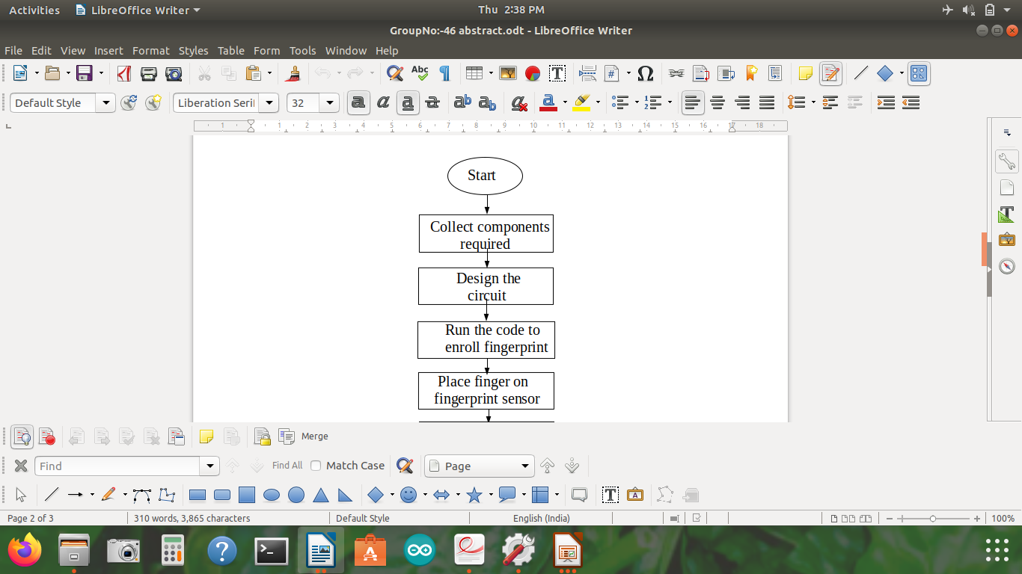
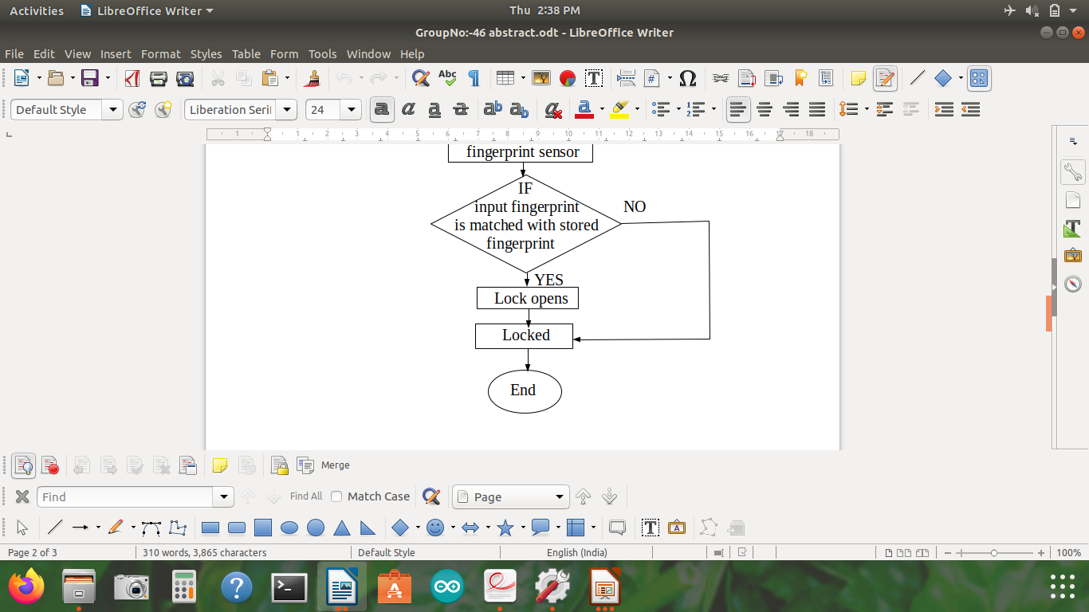
Flow chart

Slide 19
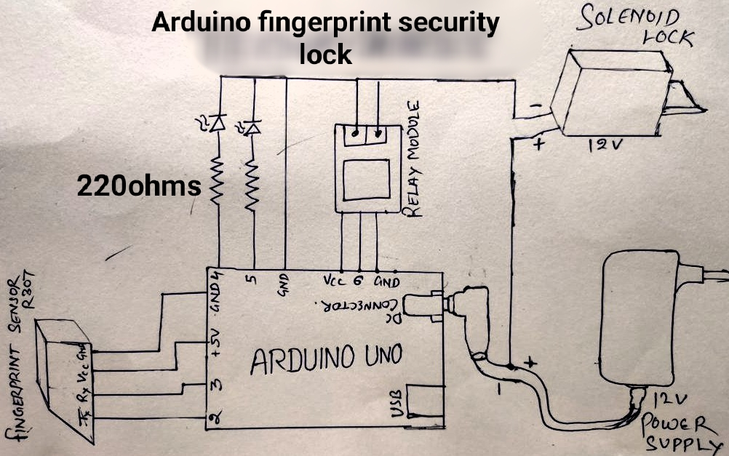
Circuit Diagram

Slide 20
Circuit Diagram Explanation
At first, we need to arrange and connect the circuit as shown in the figure.
In details, we need to interface the finger print scanner to arduino by connecting transmitting and receiving pins of fingerprint scanner to arduino digital pins to establish serial communication.
Next,interface single channel relay ,resistors and leds to arduino board. As relay used to control high voltages and currents ,which acts as open and close the contact of switch.
Resistors and Leds are used to control regulate high currents.

Slide 21
Circuit Diagram Explanation
Now just interface linear solenoid to channel relay and power supply adapter as linear solenoid requires high voltage of currents which convertes electrical energy to mechanical push or pull of lock.
To active arduino connect the arduino board to dc power supply by power supply adapter.
Now , the whole circuit is ready. The arduino board acts as brain as it make and implement instructions to control the components by making code in computer by interfacing arduino board with computer by usb cable. Now write the code for enrolling and to verify finger print with suitable conditions in arduino software.

Slide 22
Arduino code Introduction
Before discussing about the arduino code we need to know about arduino software
Arduino software is open source software
This is compatable for all the types of arduino boards
This is a crossplatform application
It is easy to write code and upload it on board by using c and c++ languages

Slide 23
Arduino code
We need two types of codes here
1) Fingerprint enroll code
2) Fingerprint verification code
1) Fingerprint enroll code
Establish connection between computer and arduino board by using software serial function.
Give baudrate.The default baudrate is 9600.
Interfacing fingerprint scanner with arduino.

Slide 24
Arduino code
Checking whether fingerprint is ready for enrollment or not using serial.parseInt() function
Give Id number to save fingerprint
Place finger on figerprint scanner.Many problems may arise as image is too messy,didnot capture fingerprint features ..etc.We use switch case and break statements to check all these conditions

Slide 25
Arduino Code
2) Fingerprint verification code
Establish connection between computer and arduino board and next interfacing arduino board with fingerprint
Define inputs and output pins of arduino board with function pinMode
Define voltages with the function digitalWrite
Define baudrate for both fingerprint scanner and arduino
Taking fingerprint from the user and compares with matched templates of previous fingerprints

Slide 26
Working
The main working principle of this security system is “matching algorithm”.it means ,the whole process depends upon matching .
Just place the finger on fingerprint scanner,the scanner sends out a light ray which takes the picture of finger print and it converts the Image into binary 0s and 1s in code format and store the data in memory template.
code is followed it first enroll the finger print and our next step is verifying finger print.
12V Power supply is given to the arduino uno R3 board,from the arduino board power is supplied to fingerprint scanner and single channel relay

Slide 27
Working
If the user finger print matches with the registered finger print , an operating signal emerges out from arduino board which acts with channel relay which makes the open or close of contact with solenoid lock. If both fingerprint matches then the linear solenoid lock opens, if not matched it remains close.
The relay and solenoid will be in off state until the fingerprint scanned be matched with previous stored templates when they get matched the relay module controls the high current used by solenoid and the solenoid converts the electric current into mechanical work.
As a result of this, the solenoid will be unlocked.

Slide 28

Advantages
Easy to use
Non transferrable
Security is maintained.
It is cost efficient
No external memory is needed.
Crime rate will be reduced.

Slide 29

Disadvantages
It totally depends on Electricity.If there is no electricity we cannot do anything.
Not possible to take authentication with sweat hands
Circuit may be damaged at high temperatures
System failure
Damaging

Slide 30

Applications
Fingerprint based driving license
Bank account operations
Biometric security
Attendance
Crime investigations

Slide 31
Conclusion
The main moto of this project is to create a securable environment in the society to decrease tremendous increase of crime rate by using technology.
We mainly optimize the user privacy,which can be damaged by unauthorised users.
Hence,fingerprint door locks are great investment for home or bussiness.It provides great security by providing restrictions to unwanted access

Slide 32


